Slide 1
CRYPTO NEWS SITE
CVN Sai Charan 1602-16-737-035
Sasanka 1602-16-737-042
P Arun Kumar 1602-16-737-307

Slide 2
ABSTRACT
Crypto currencies are the future assets.
This site gives you all the latest streaming
pricing data in the world of crypto currencies.
Over the past few years, crypto currency has
grown exponentially because of its attractiveness
to people looking to use this alternative money.
They’re decentralized (no banks!), anonymous and
electric, they've got the potential to change the world.

Slide 3
This site gives you all the latest streaming
pricing data in the world of crypto currencies.
Returns news articles from the providers that
Crypto Compare (API) has integrated with.
This site is a simple, fast, powerful and live
converter & calculator. It helps you to convert
any digital currency to other.

Slide 4
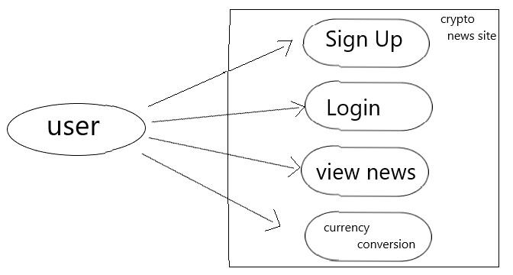
USE CASE

Slide 5
Contd..
The users should be able to create account with valid username and password.
Users can login and view the latest news articles.
Users can view streaming pricing data of currency .
Users can convert one form of currency to another form of currency.

Slide 6
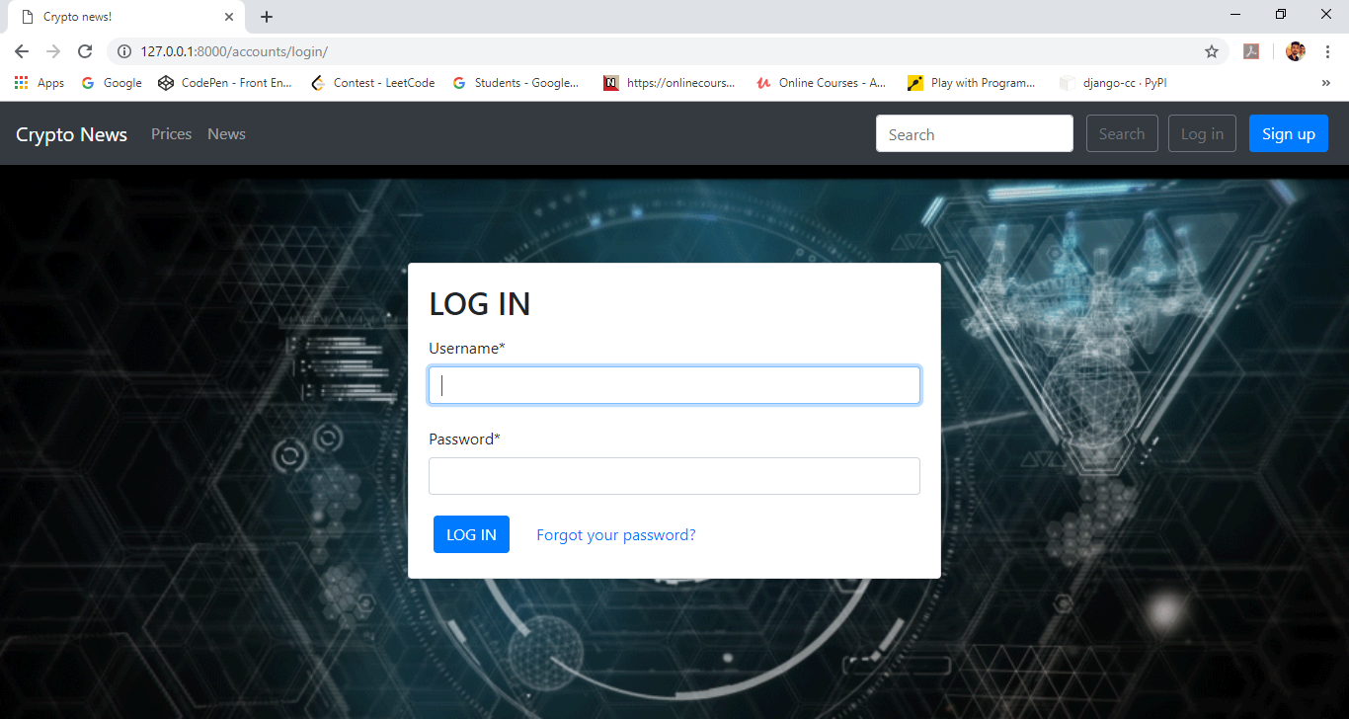
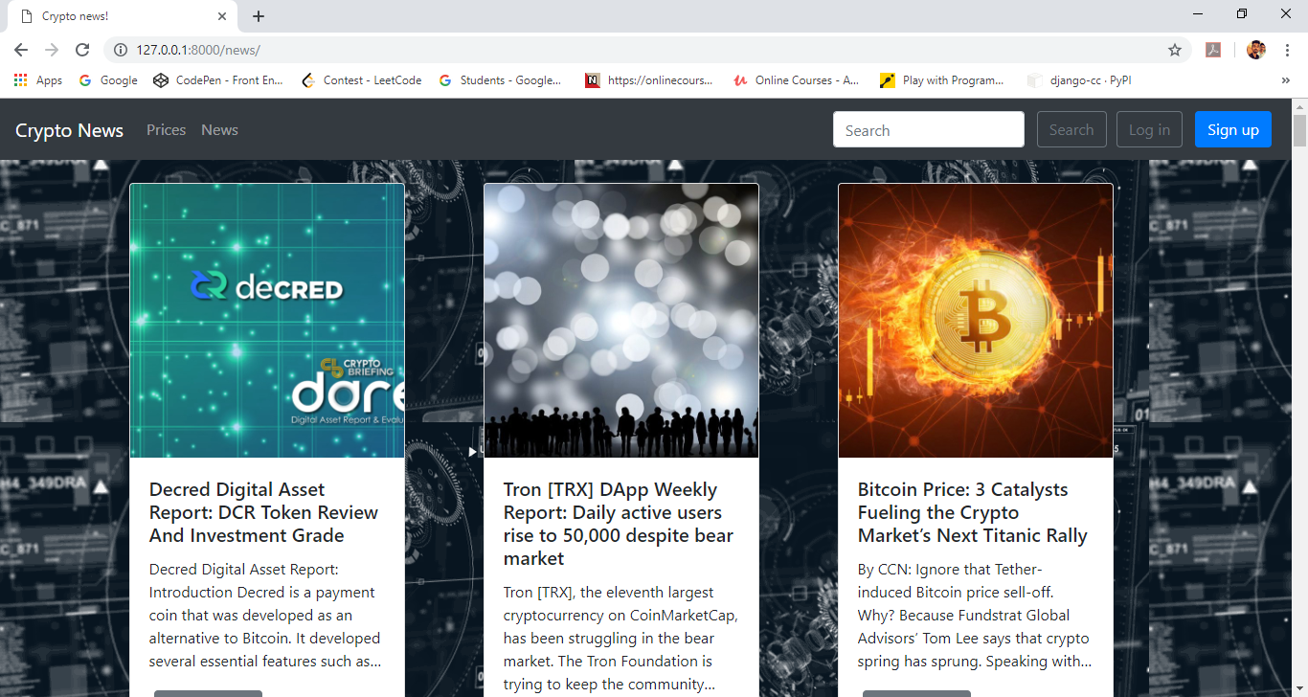

Slide 7
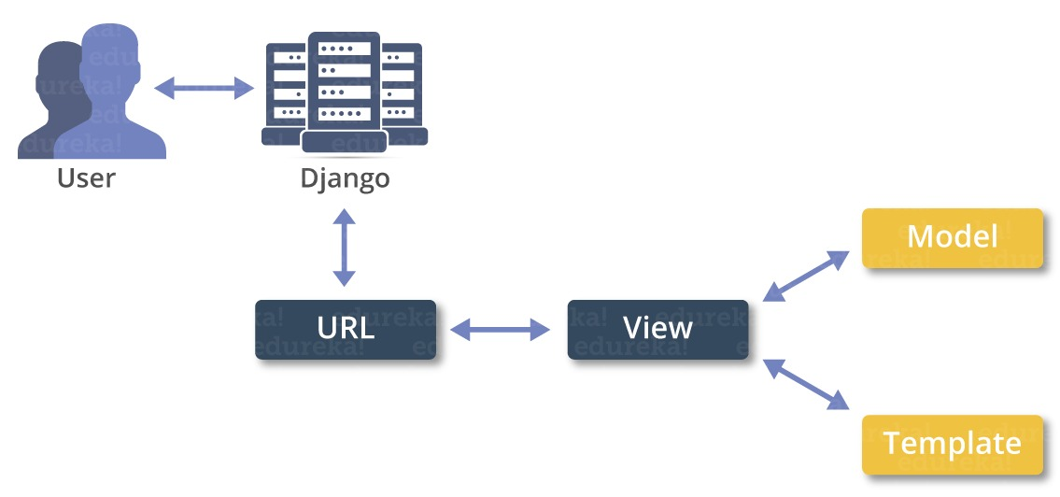
ARCHITECHTURE USED
The project is based on django.

Slide 8
TECHNOLOGIES USED
Additional frameworks used are:
Front End:
HTML
CSS
JAVASCRIPT
BOOTSRAP
Back End:
DJANGO Framework
PYTHON

Slide 9
RESULTS
Our project enables the users to create account and view the latest articles.
The dynamic news feed enables the users to be updated about the crypto news
The converter is simple yet powerful, converts one currency to another.

Slide 10
Conclusion and future work
We planned to improve our project by adding additional features.
The main feature is we will provide a wallet for the users who created account.
They can then have transaction between users to exchange crypto currencies according to the value in market.

Slide 11
THANK YOU

